Slide 1
Real-Time Sound Analysis / Synthesis
Michelle Qiu
Germain Martinez
Gerzain Mata

Slide 2
Overview
Use FPGA buttons and switches for navigation
The user sings/ hums/ plays an instrument
A microphone picks up the sound
The sound is saved onto memory for later playback
Audio effects can be added to the sound samples
Multiple audio samples can be recorded and played

Slide 3
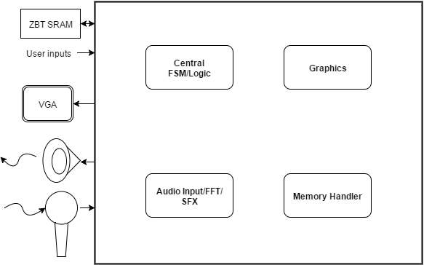
Main Modules and External Components

Slide 4
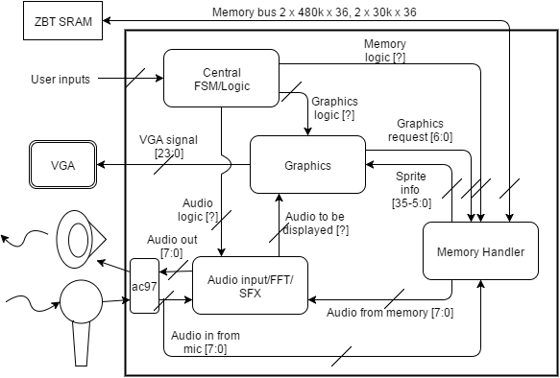
Block Diagram

Slide 5
Central FSM
Processes user inputs
Coordinates the modules
Choose which bank to record to and what effects to apply when playing back
Each team member implements part of the FSM most pertinent to their individual module

Slide 6
Central FSM
Time out
Record
Stop
Standby
Record
Playback
Playback
Time out
Stop

Slide 7
Specific Number Figures
24 kHz sampling rate and 12 bit encoding scheme
288 kilobits per second data rate
~80 kAddresses of ZBT memory required for 10-second recording
Use one bank of memory for each sound recording
2952K bits of BRAM available for images for graphics

Slide 8
Memory Handler
Take in input from microphone
Write audio samples to memory
Retrieve sound samples from memory upon request
Use ZBT Memory – two 512k x 36 bit memory bus
Notes:
8

Slide 9
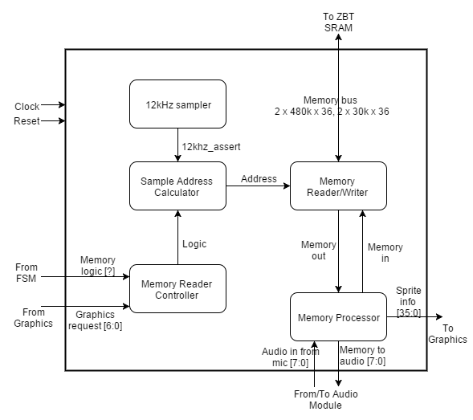
Memory Handler – Block Diagram

Slide 10
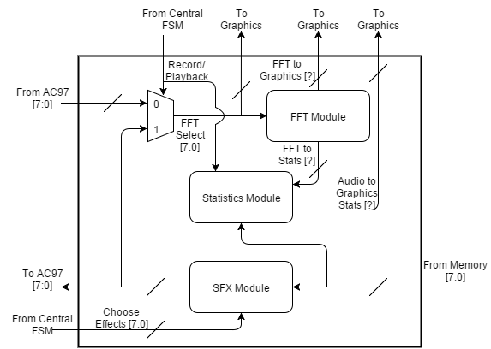
Audio Module - Block Diagram

Slide 11
Audio Module
Process input from microphone and write to memory
Take effects from FSM and apply them to recorded audio
Output FFT data to Graphics module
Output sound to speaker
Most complex part of project

Slide 12
Audio Module - Proposed Effects
Compression & Limiting
Delay & Echo
Expansion & Noise Gate
Phasing
Chorus (if time allows)
Vocoders (stretch goal)

Slide 13
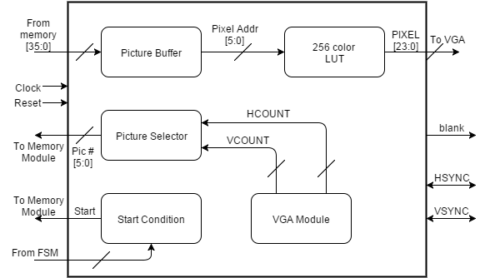
Graphics Module – Block Diagram

Slide 14
Graphics Module
Take in graphics from memory
Output FFT spectral data
Display running statistics (predominant frequency, amplitude, sample characteristics)
Take in preloaded data from block ROM
Data saved as 6 bit pixel encoding
6 bit pixel encoding -> 24 bit color to VGA -> LUT
Minimum 30+ different images for text/numbers/etc. (30 kBits)

Slide 15
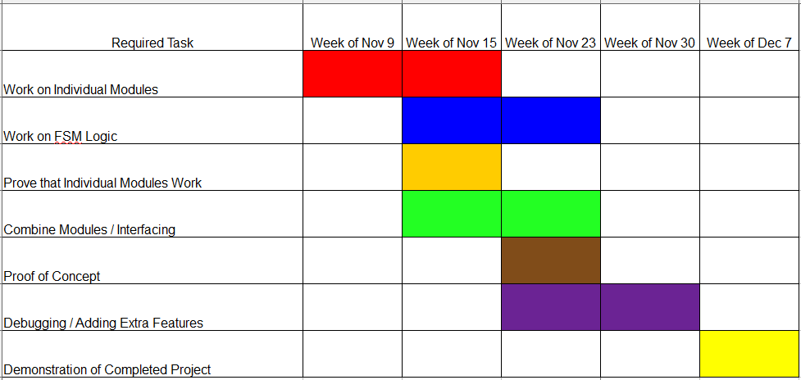
Task Timeline

Slide 16
Forseeable Challenges
Getting FFT and statistics in real-time
Simultaneous and offset playback of different recordings for sound effects and playback
Effect complexity
Possible source of latency
Multiple effects at the same time?
Playing multiple sound clips at the same time

